Slide 1
Adjustment Information on EUCLID

Slide 2
Who creates a Schedule of Adjustments (SoA)?
Created by a Disability Advisor at the Student Disability Service
The student is present when the SoA is created.
Adjustments chosen are based on the medical evidence and information provided by the student.
Once the student and Disability Advisor have agreed the adjustments required, the Advisor submits the SoA via EUCLID.
The SoA is now live and available to those who have access.

Slide 3
Who is the information shared with?
Coordinator of Adjustments (CoA)
Course Organiser (CO)/Course Secretary(CS)/Teaching staff
Personal Tutor, PG Supervisor, Student Support Officer
Ad Hoc Staff (can be added)
Student

Slide 4
How is the information disseminated?
Coordinator of Adjustments (CoA)
Access to Schedule of Adjustments Inbox, all adjustments in School, by student
Access to the Course Adjustment Breakdown to view adjustments by course
Access to the SoA via the student’s individual record.
Course Organiser/Course Secretary (CO/CS)
Access to the Course Adjustment Breakdown
Relevant courses will be listed automatically
Information listed by Adjustment (e.g. 10 students need x adjustment)
Student details will be provided as appropriate (e.g. name, photo)
Learning & Teaching summary can be created for teaching staff
Receive a daily summary of any new, updated or removed SoA.
Teaching staff: Access to the Learning & Teaching summary for their course which is either sent to them as a PDF by CO/CS, or viewed via EUCLID (requires CO/CS action).
Personal Tutors, PG Supervisors, Student Support Officers: Access via the student’s EUCLID record for relevant students.
Ad Hoc Staff: can be added to have access to a particular student’s Schedule of Adjustment by the CoA.
Student: Views their SoA via MyEd self-service portal.

Slide 5
How do staff gain access to the information
Course Organiser/Course Secretary, Student Support Officers, Personal Tutors, PG Supervisors
Automatically gains access to their relevant view once their role has been assigned on EUCLID.
Coordinator of Adjustments (CoA)
Primary CoA emails the Student Disability Service (SDS) to authorise CoA access should be given. SDS will raise a call with Student Systems to assign CoA access.
Teaching staff
Sent PDF of Learning & Teaching summary or given access via EUCLID by the CO/CS or CoA.
Ad Hoc Staff
Can be given access to a specific SoA by the CoA.

Slide 6
Schedule of Adjustment Inbox (CoA View)
When you open the dashboard you will see:
Any SoA that requires reviewing, this will be stated in in a blue box at the top of the dashboard
If you have viewed the SoA before
If another CoA in your School has view the SoA
The version of the SoA will be indicated by the v# in the schedule column.

Slide 7
Schedule of Adjustment Inbox (CoA View)
What the different tabs on the dashboard mean
Pending: SoAs that still need to be viewed and marked as reviewed by a CoA in your School.
Current: Current SoAs that have been reviewed by a CoA.
Inactive: Schedules that are no longer meet the criteria for your School. The student may no longer be current / enrolled on courses in your School. They'll drop off this list after 30 days.
Closed: Schedules that are have been closed with no new schedule created. For example a student with a temporary injury that no longer requires support. They'll drop off this list after 30 days.

Slide 8
Schedule of Adjustment Inbox (CoA View)
How to open and view a student's full SoA
Click on the ‘schedule v#’ or ‘open’ to see the full schedule. This will show:
If the schedule is new or updated
The date it was published and by whom
If there is a review date for the schedule (normally in place for temporary injuries)
There will also be a summary of any new, update, or removed adjustment at the top in a blue box.
As you scroll down you can see each adjustment in detail and at the bottom will be a list of any removed adjustments.

Slide 9
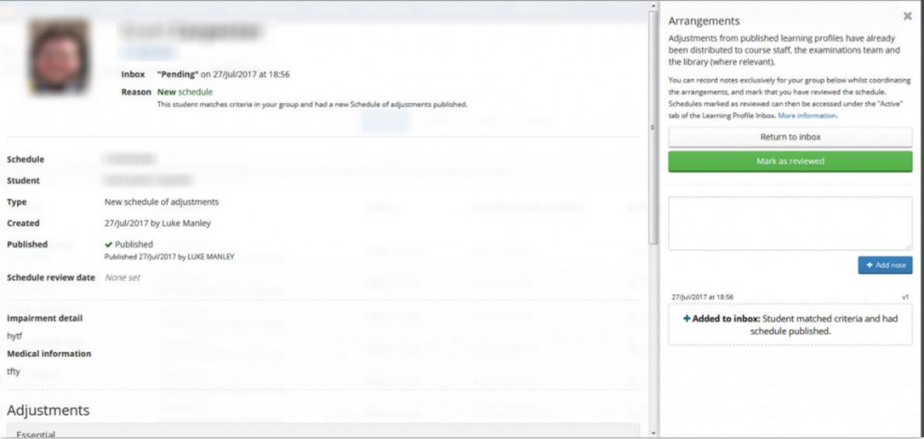
Schedule of Adjustment Inbox (CoA View)
How to create notes and flag schedules for members of your team
To the right of an open SoA you will see a window that allows you to record notes for your CoA team e.g. you may want to record that you have started an action against this SoA.
NB: these notes are only available to CoAs within your School. SDS or the student will not see them.
If you don’t want to mark the SoA as reviewed, you can click ‘return to inbox’. This will ensure that the SoA remains in the ‘pending’ tab.
If you are happy with this SoA and feel no further work need be done by you, you can click ‘mark as reviewed’ and the SoA will shift to the ‘current’ tab.

Slide 10
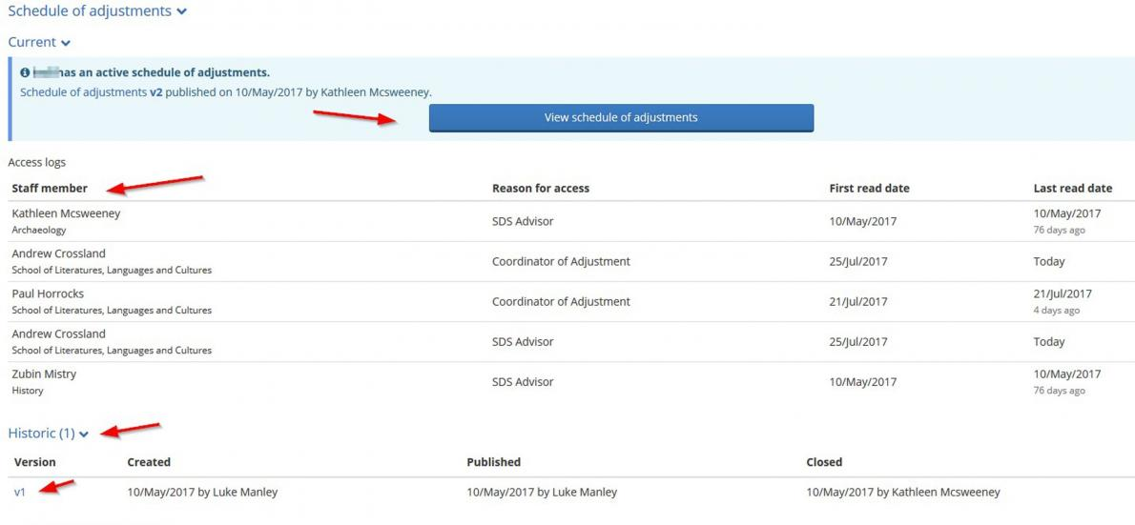
Schedule of Adjustment Inbox (CoA View)
How to view historical versions of a schedule
You can view historical versions of a student’s SoA by accessing their record in the Student Hub on EUCLID where you can:
View the full SoA
See which staff members have access to the SoA
See historic versions of the SoA
To view the full historic versions, click on the v#.

Slide 11
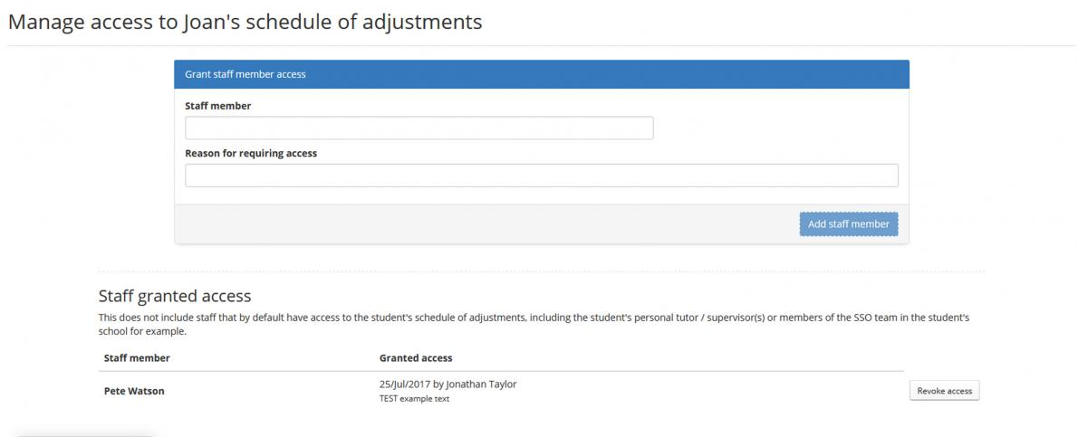
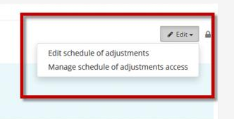
Schedule of Adjustment Inbox (CoA View)
How to give a staff member access to a specific student's SoA.
From the schedule of adjustment click the "Edit" button and select "Manage schedule of adjustment access“
Enter the staff name requiring access in the "Staff member" field
Select the relevant member of staff complete the "Reason for requiring access field" and click the "Add staff member" button.
Use the "Revoke access" button next to the relevant staff member if access is no longer required.

Slide 12
Course Adjustment Breakdown (CO/CS View)
How to select your individual courses
All courses you are associated with should be listed in a drop down menu under the ‘My courses’ section.
There is an option to select different years and instances. Some courses have multiple instances in a year taught across multiple semesters and some split visiting students/non-visiting student into separate instances. This allows you to drill into that subset of the students if required.
CoAs will not have a prepopulated list but can look up any course by using the ‘Lookup course’ search option. This option only shows for CoAs.

Slide 13
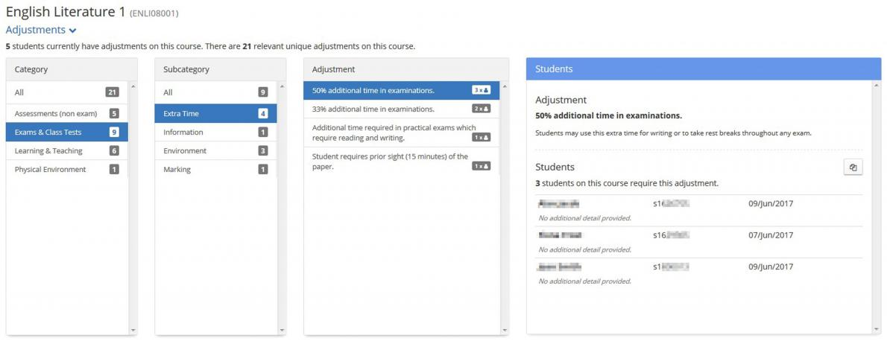
Course Adjustment Breakdown (CO/CS View)
How to view the adjustments required for your courses
Select a course to see the summary of adjustments required for that course
The summary can be broken down into categories: adjustments in selected categories will be revealed in the box at the right
The number of students in each category of adjustment shows in the grey boxes
Select a specific adjustment to see the individual students with that adjustment.

Slide 14
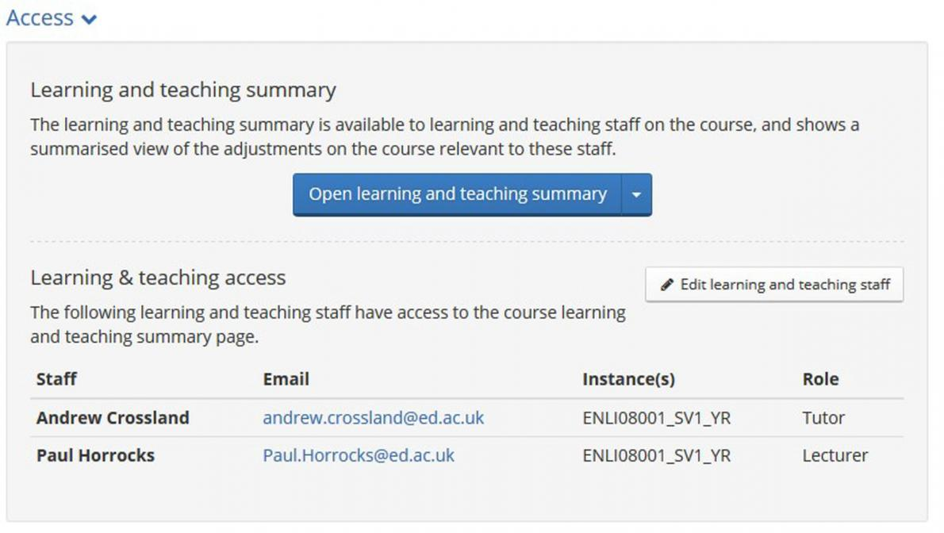
Course Adjustment Breakdown (CO/CS View)
How to view a Learning & Teaching (L&T) Summary
At the bottom of the screen there is a section headed ‘Access’: click on the 'Open learning and teaching summary' button
This opens up a summarised view of the adjustments for that course
When viewed online, the L&T summary will time out after a few minutes to avoid inadvertently revealing sensitive information.
How to share a Learning & Teaching (L&T) Summary with teaching staff
There are two ways to share this information with teaching staff.
Grant the relevant teaching staff access to this screen on EUCLID
Distribute a PDF or print out to the relevant teaching staff.

Slide 15
Student Record (SSO/PT/PGR Supervisor view)
How to access and view a student's Schedule of Adjustments (SoA)
Open the student's record in EUCLID and click on the blue button 'View schedule of adjustments'.

Slide 16
Who should you contact if you have a query about a SoA?
Contact the advisor who published the SoA (listed on the SoA).
CO/CS contact: disability.service@ed.ac.uk
Name | Email | Direct Line
Marian Grimes | Marian.grimes@ed.ac.uk | 514 002
Suzanne Hewitt | Suzanne.hewitt@ed.ac.uk | 515 036
Hazel Hume | Hazel.hume@ed.ac.uk | 506 504
Angela Joyce | Angela.joyce@ed.ac.uk | 506 503
Jahanara Khatun | Jahanara.khatun@ed.ac.uk | 515 038
Karen Scott | Karen.scott@ed.ac.uk | 509 164
Kathy Smith | Kathy.smith@ed.ac.uk | 514 001

Slide 17
Our Management Team can also be contacted directly regarding general or recurring issues:
SDS Staff Contact | Role | Direct Tel. | Email | School/Deanery/College/Service
Paddy Corscadden | Director | 0131 650 9165 | Paddy.Corscadden@ed.ac.uk | Edinburgh Medical School Deanery of Biomedical Sciences Deanery of Clinical Sciences Deanery of Molecular, Genetic & Population Health Sciences Royal Dick School of Veterinary Studies School of Economics
Victoria Buchanan | Assistant Director | 0131 651 4785 | Victoria.Buchanan@ed.ac.uk | Edinburgh Business School Edinburgh College of Art Examinations Team School of Engineering School of Geosciences School of Law School of Physics and Astronomy
Jan Gardiner | Assistant Director | 0131 650 2354 | Jan.Gardiner@ed.ac.uk | School of Biological Sciences School of Informatics School of Literature, Languages and Cultures School of Mathematics School of Philosophy, Psychology and Language Sciences School of Social and Political Sciences
Martin Judd | Assistant Director | 0131 651 5037 | Martin.Judd@ed.ac.uk | Centre for Open Learning Moray House School of Education School of Chemistry School of Divinity School of Health in Social Science School of History Classics Archaeology

Slide 18
Further guidance is available at www.ed.ac.uk/student-systems/support-guidance/admin-support-staff/student-admin-support-services/disability-service

